Slide 1
Library management system
Presented by:
Umesh Raj Joshi
Yuvraj Karki
Prince Kumar Chaudary

Slide 2

Introduction
Library management system is the digitally management system of basic operation of library which are done by the librarian. A library management system (LMS) is a software application designed to manage the operations of a library. It provides functionalities to handle various tasks related to the administration, cataloging, circulation, and inventory management of library resources. The basic function are in this library management system are add book, delete book, search book, view book list, issue book and return book.

Slide 3
Problem statement
Old LMS system are based on the more paper work which is complex to manage library transaction and saves records.
In the old LMS system there is a problem of data lost and problem of management books data due to mannual which make complex for librarian.

Slide 4

Objective
To solve the data loss issue in the library.
To reduce the paper work in the library.
Make a easy, comfortable and permanent data stored library management system.

Slide 5

Scope
Used in the library for a reducing the paper work.
Used in library for the managing books in library in effectively and make library work fast and easier.

Slide 6
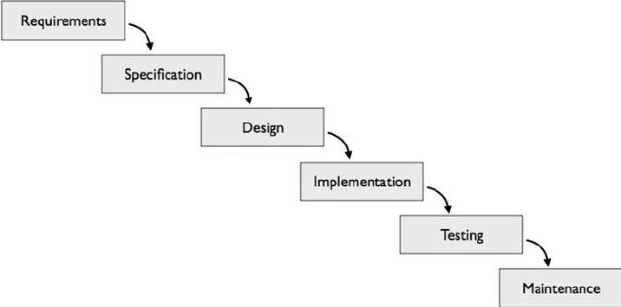
Waterfall model

Slide 7
Start
Read username and password
n=1
Login
Welcome user

Slide 8
Enter 1 for LMS
Exit
Opt 1
No
Yes
Welcome to library management system
Opt 2
Display menu
Issues book
Return book
Search book
Update book
Setting
Exit
Program terminated
Opt 1
Yes
No
Issues book

Slide 9
Enter book name, student name, giving date, return date
Opt 2
Yes
Return book
No
Enter book name, student name
Opt 3
Yes
Search book
No
Enter book name or book no
Opt 4
Yes
Update book

Slide 10
Opt=3
Yes
No
See book list
Opt=4
Exit
Opt 5
Display menu
Enter 1 for change password
Enter 2 for change username
Enter 3 for exit.
Yes
Read opt
Opt 1
Yes
Change password
No

Slide 11
Opt 2
Change username
Opt 3
Exit
Exit

Slide 12
Use case diagram
Login
Issue book
Return book
Update book list
Search book
See book list

Slide 13
Gantt chart
GANTT CHART
TASK | WEEKS
 | 1 | 2 | 3 | 4 | 5 | 6 | 7 | 8 | 9 | 10 | 11 | 12 | 13 | 14 | 15
Project study
Planning & research
Product requirement analysis
System design
Coding
Integration & implementation
Documentation

Slide 14
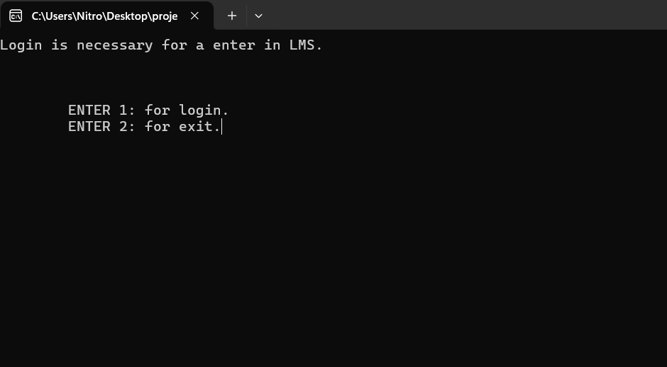
first page

Slide 15
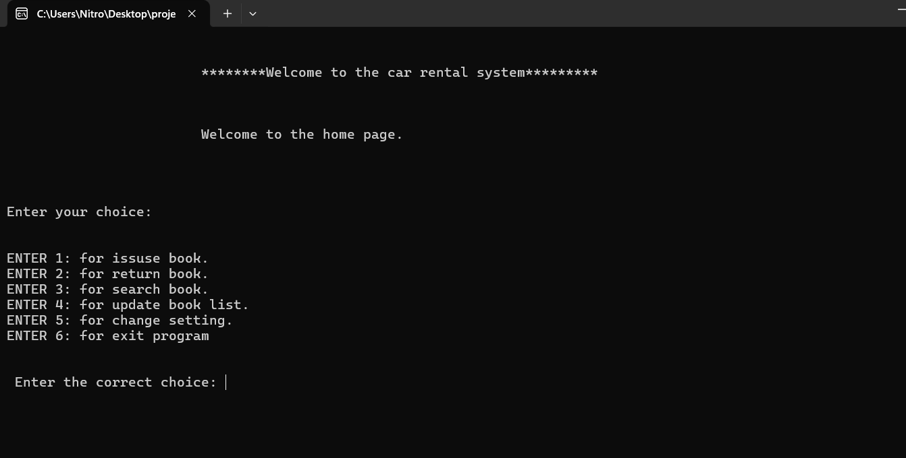
main menu book page

Slide 16
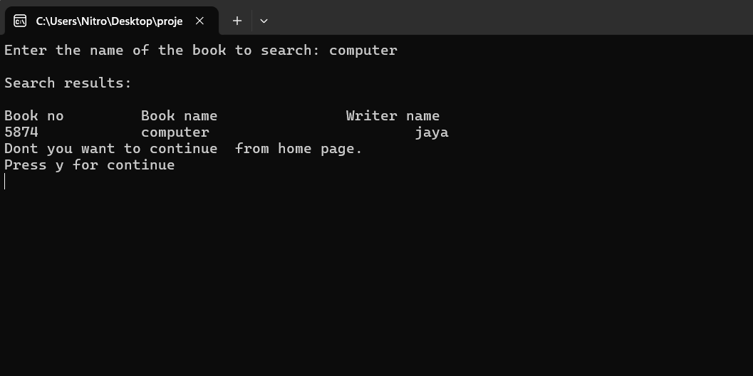
Search book page

Slide 17
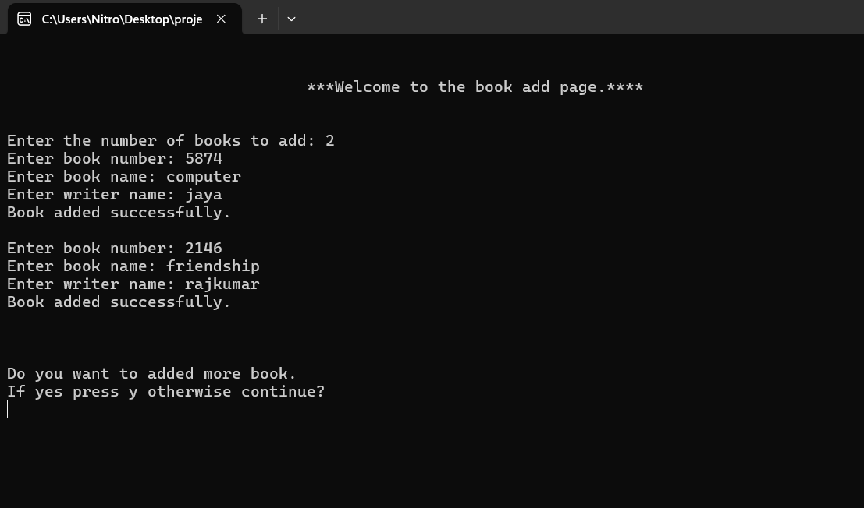
add book page

Slide 18
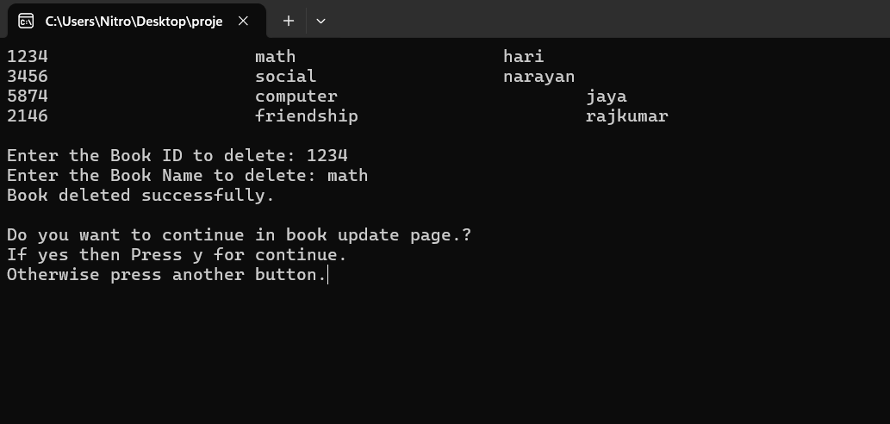
Figure 14: Delete book page

Slide 19
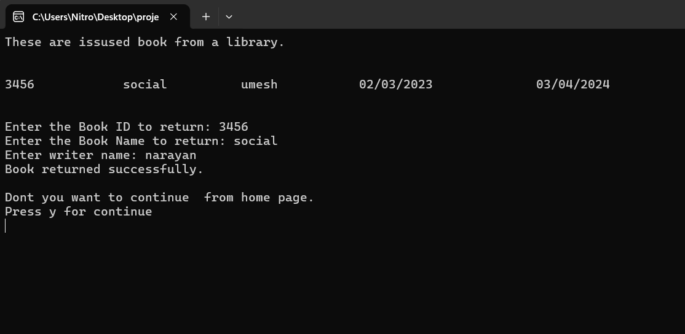
Issue book View page

Slide 20
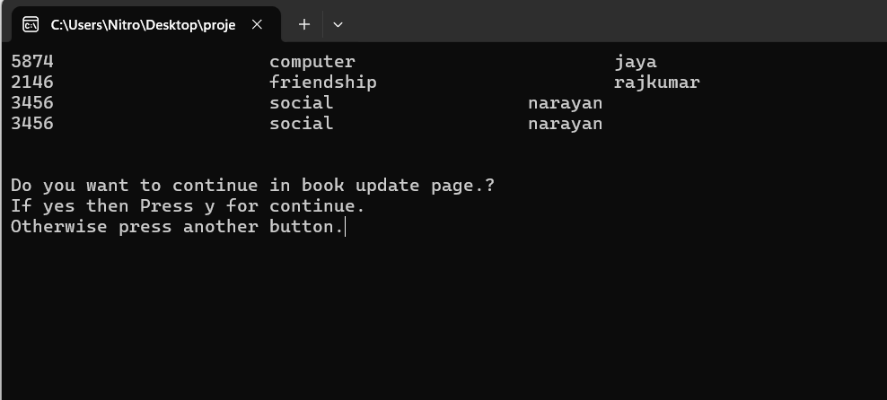
View book page

Slide 21
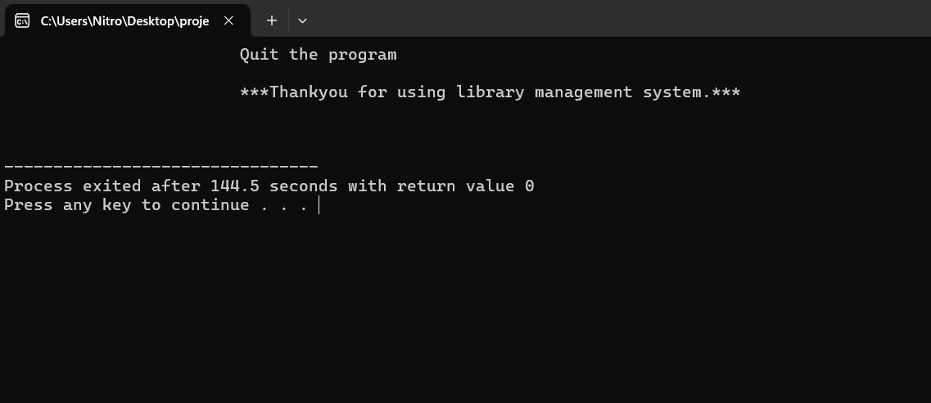
view exit page

Slide 22
Conclusion
In conclusion, the Library Management System developed using C language efficiently addresses the essential needs of managing library data with functionalities such as adding, deleting, issue and return book, modifying, viewing, and searching available books. It ensures secure access through user authentication, safeguarding sensitive information. It also provides a register password and username before first time signing in into the system. The system's intuitive interface and platform independence make it a practical and versatile solution for streamlining administrative tasks, improving data accuracy, and enhancing productivity.

Slide 23
References
Abir Roy and anindita mridha (2024). Programming in Dev C++ C(datim.org.np).BCA student
Library Management System Project in Software Development (geeksforgeeks.org)
[Accessed 17 march]
[2] Prabhakar kumar and Rahul (2018). Using c programming language (ACADEMIA). Computer engineering student of Cohin University of science and technology. [Accessed March 17]
(PDF) Library Management System Mini Project Report On LIBRARY MANAGEMENT SYSTEM | Bibek Chaulagain and Bilal Awan - Academia.edu [March 17]
[3]GLEVIN STANISLAUS GAGA (2021). Using c programming language to developed this system. BIT student of university of Mumbai.
(PDF) The Digital Library Management System 2021: Design and Implementation of an integratedLibraryManagement System (researchgate.net) [accessed March 17]
[4] MRS Swaroop (2017). Using c language to develop this system. MSc computer student of “university of east London”. Library management system final Report - Project Report on ONLINE LIBRARY MANAGEMENT SYSTEM - Studocu [accessed March 17]

